Slide 1
Dani’s stock dock: Stock menu program
Danyella Nieto
June 22, 2023
CEIS 150

Slide 2
Agenda
Introduction
Project Challenges
Career Skills
Module Breakdowns
Conclusion

Slide 3
Introduction
The project provided experience creating applications in Python. Object-oriented techniques were used to develop a stock tracking application. By processing the historical stock data, profit/loss reports can be generated. Data storage will allow users to save and retrieve stock data. The system will use the Python libraries to create charts.

Slide 4
PROJECT CHALLENGES
I was unable to complete the project in Spyder as I had several issues with trying to run the program, so I had to quickly adapt, and problem solve
Several times I received indentation errors so I had to go through the code to identify the line to correct
Since I was not utilizing Spyder through Anaconda, I had to learn how to download needed libraries in VS Code

Slide 5
Career skills
Object oriented skills
Creating charts
Creating user friendly GUI’s
Downloading and utilizing libraries
Using classes, inheritance, and encapsulation
Downloading, importing and opening files and integrating that into the program

Slide 6
Module break downs
Modules 1-7

Slide 7
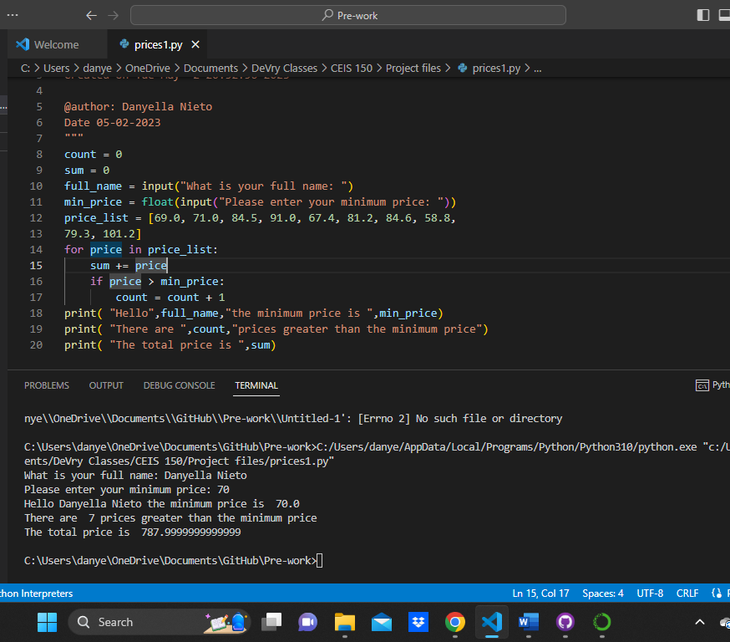
Module 1
Software Environment Setup
Screen shot of Python program running successfully.

Slide 8
Module 2
Class Diagrams
Class Coding
Unit Testing

Slide 9
Class Diagram
Visio Class Diagram

Slide 10
Class Code
Screen Shot of stock_class.py file.

Slide 11
Unit Test
Screen Shot of successful unit test.

Slide 12
Text-Based User Interface Summary Report
Module 3

Slide 13
Adding a Stock
screen shot of working Stock program.

Slide 14
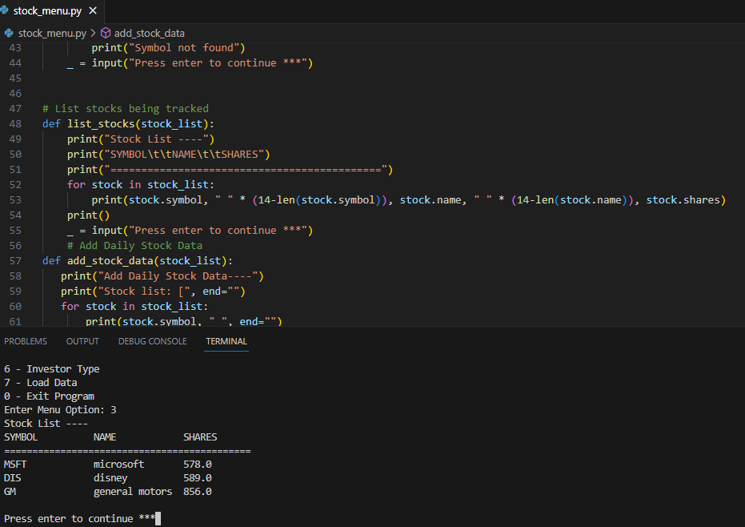
Listing 3 Stocks
screen shot of working Stock program.

Slide 15
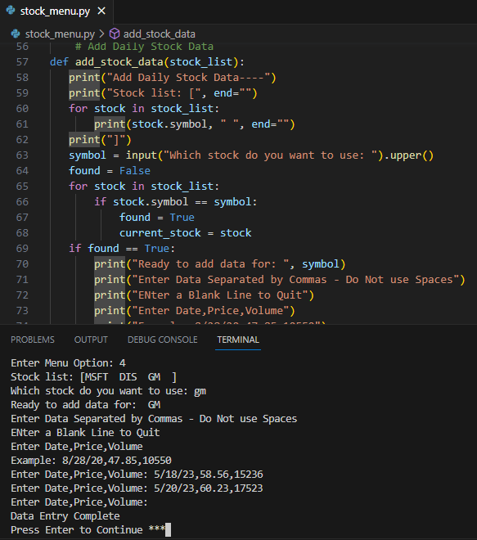
Daily Data
screen shot of working Stock program.

Slide 16
Module 4
Inheritance
Summary Report

Slide 17
Inherited classes
Screen shot of classes

Slide 18
Unit Tests
Screen shot of unit tests successfully completion

Slide 19
Stock menu program
Screen shot of classes in the main program

Slide 20
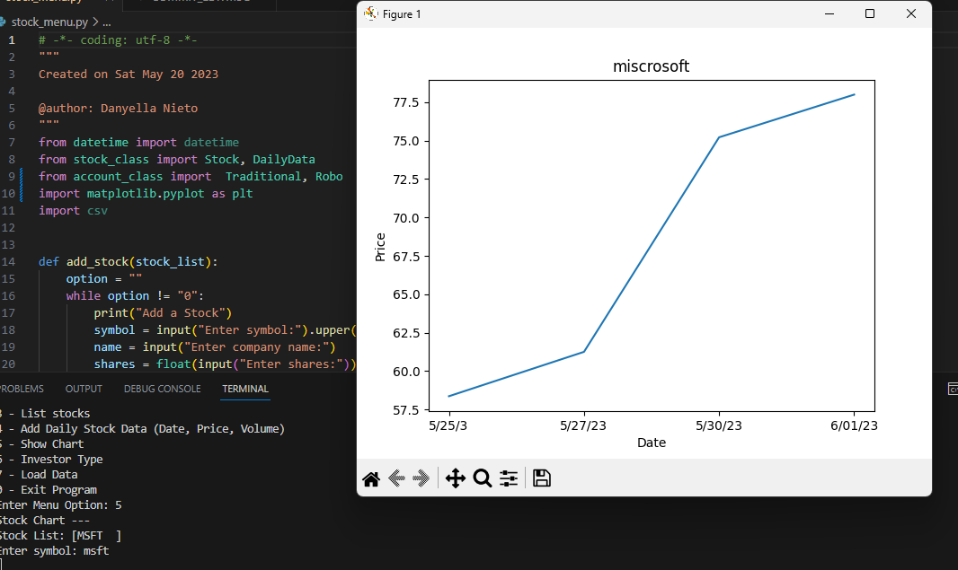
Module 5
Creating a Chart

Slide 21
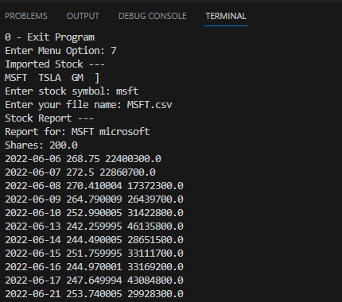
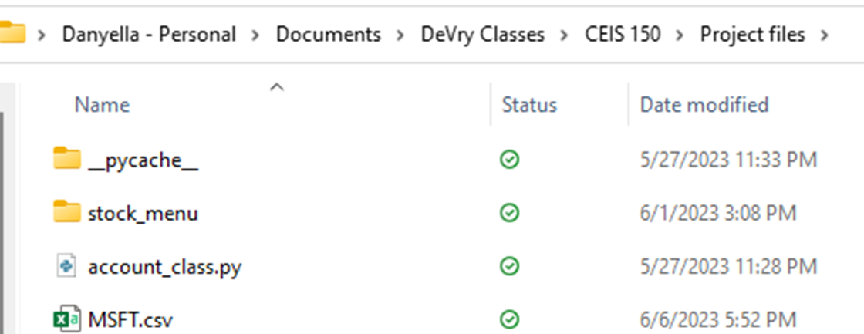
Module 6 : Loading Data
Importing data
File
screen shot of the file downloaded from Yahoo finance
Screenshot of the historical data import

Slide 22
Module 7: GUI

Slide 23
Stocks in GUI
Paste a screen shot of your GUI working

Slide 24
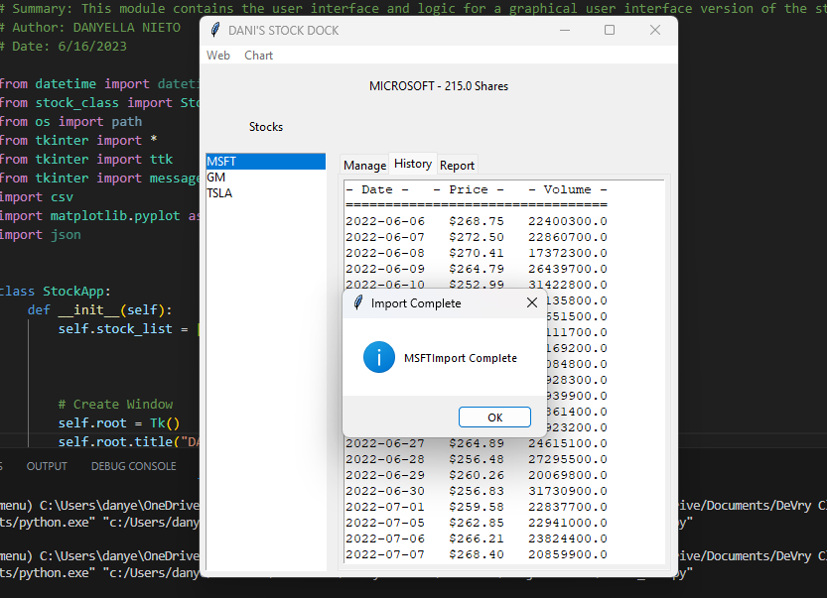
History Tab
screen shot of History tab with import working.

Slide 25
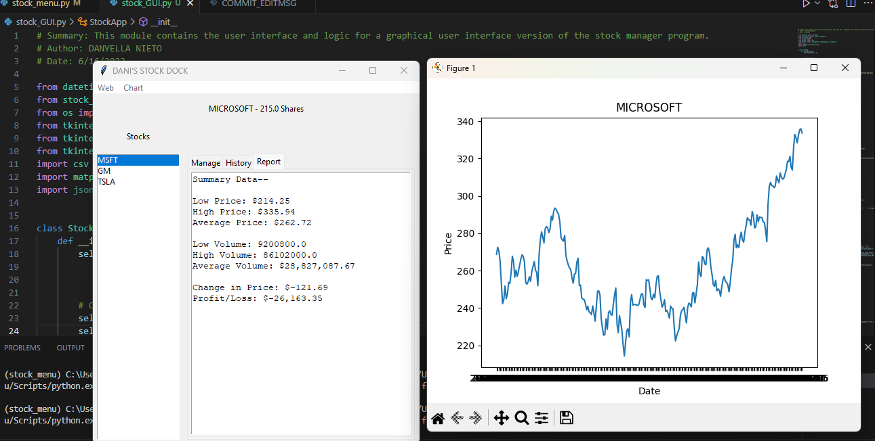
Report Complete
Screen shot of Report tab

Slide 26
Conclusion
Creating this program has been very rewarding. The skills gained from this project are transferable and applicable to real life job situations. There have been challenges faced in the process but persevering and overcoming them are what have made me a better software engineer and student.

Slide 27
Thank you
Danyella Nieto
dnieto4@my.devry.edu
https://dnieto47.wixsite.com/danyella-s-technical

