Slide 1
Fundamentals of Information System Security
Danyella Nieto
SEC285

Slide 2
Agenda
Intro
Module 2
Module three
Module four
Module five
Module six
Challenges & career skills

Slide 3
Introduction
The following project is the sum of topics taught in SEC285. This course covered topics from malware identification, multistep authentication and producing a secure network.

Slide 4
Asymmetric Key Encryption
Module Two

Slide 5
File Encryption
This screenshot will show the following.
Content of the plaintext file
Content of the encrypted file

Slide 6
File Decryption
This screenshot will show the following.
The encrypted file being listed by itself
The decrypting process
Both the encrypted file and the original plaintext file being listed

Slide 7
Stateful Firewall
Module 3

Slide 8
Question
What effect does the sudo iptables --policy INPUT DROP command have on the access to computing resources?
The sudo iptables –policy INPUT DROP command closes all ports that can be accessed as attackers look for open ports that they can use an entry point. Each open port provides a means by which an attacker may gain access to the server. Our goal
is to only allow web (HTTP and HTTPS), email (SMTP), name resolution (DNS), and SSH services
References: Module 3 project activity

Slide 9
Nmap Scan
This screenshot will show the Nmap scan result of the Linux Server VM.

Slide 10
BYOD Security Policy
Module 4

Slide 11
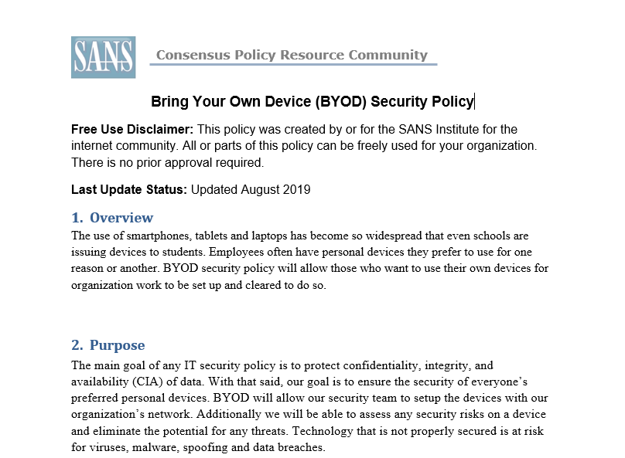

Slide 12
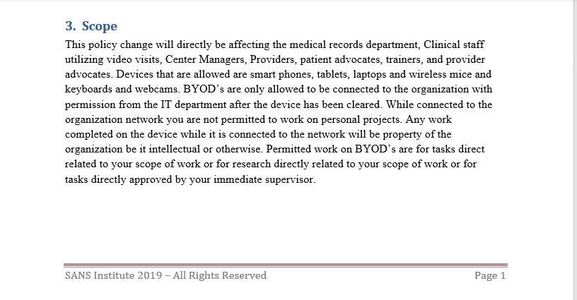

Slide 13
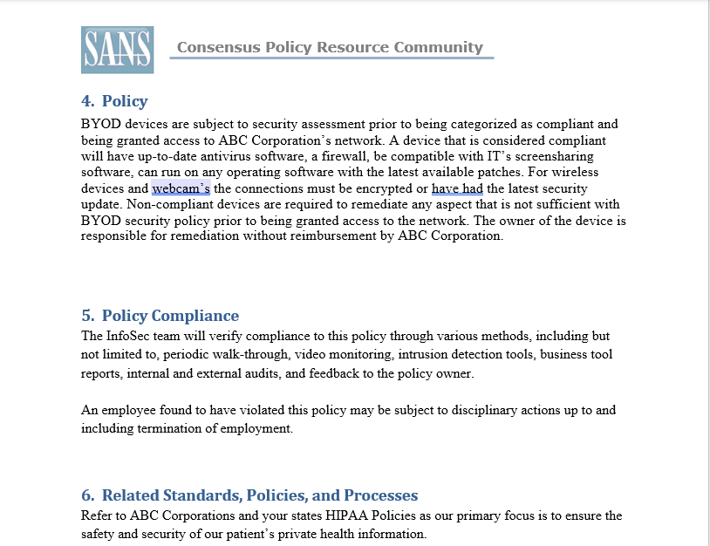

Slide 15
Multifactor Authentication (MFA)
Module 5

Slide 16
Common-auth Configuration File
This screenshot will show the entry that indicates the use of the Google Authenticator module.

Slide 17
MFA Logon Screen
This screenshot will show the logon screen where a verification code is required.

Slide 18
Vulnerability Assessment
Module Six

Slide 19
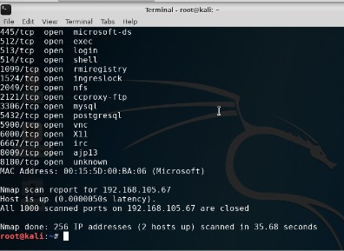
Nmap
This screenshot will include the scan result showing both the Kali and Linux Server VMs.

Slide 20
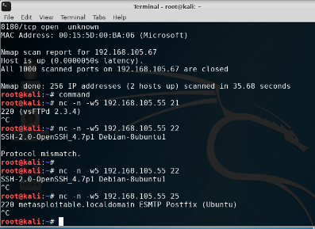
NetCat
This screenshot will include the scan result showing both the Kali and Linux Server VMs.

Slide 21
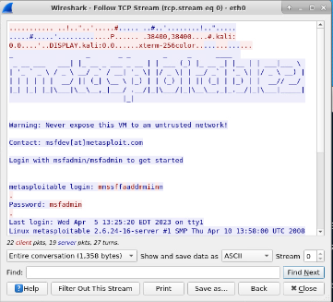
Wireshark
This screenshot will include the Wireshark—Follow TCP Steam window showing the Telnet username and password.

Slide 22
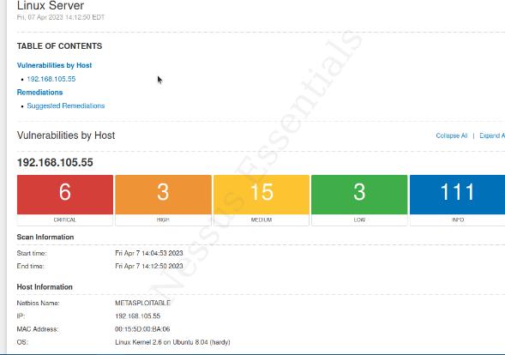
Nessus
This screenshot will include the high-level view of the Nessus vulnerability scan report (showing categories of vulnerability in different colors).

Slide 23
Challenges

Slide 24
Career Skills

