Slide 1
CEIS 110 Programming with Data
Danyella Nieto

Slide 2
Introduction
Data is growing exponentially
This project uses a cloud-based system to gather temperature and humidity data
Then the data is analyzed using programming and data analytics

Slide 3
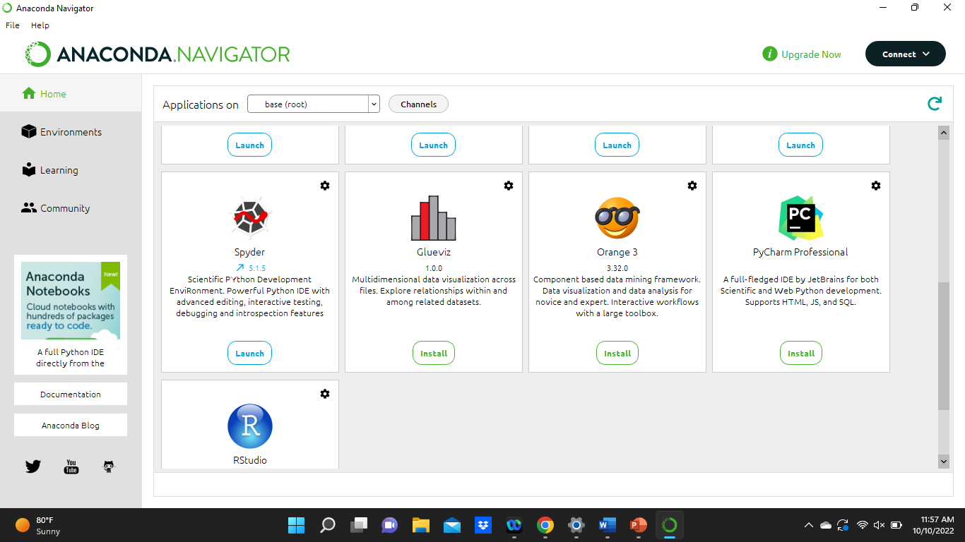
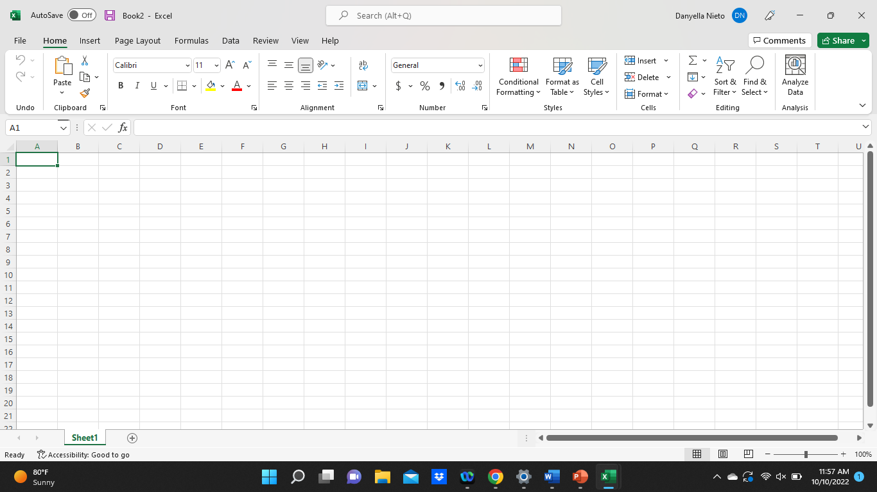
Software
The software needed for the project includes:
Microsoft Excel
SQLite
Anaconda Navigator with Spyder

Slide 4
Planning and Design
After performing an inventory of the software needed for the project, a plan was created for the temperature data project
To plan the design of the project, a flowchart was generated
Planning and design of the project are crucial steps to understanding the development process

Slide 5
What are Flowcharts?
Flowcharts are graphical representations of processes or workflows, and the flowchart developed illustrates the process and the input of this software development project
Many companies use flowcharts as simple narratives

Slide 6
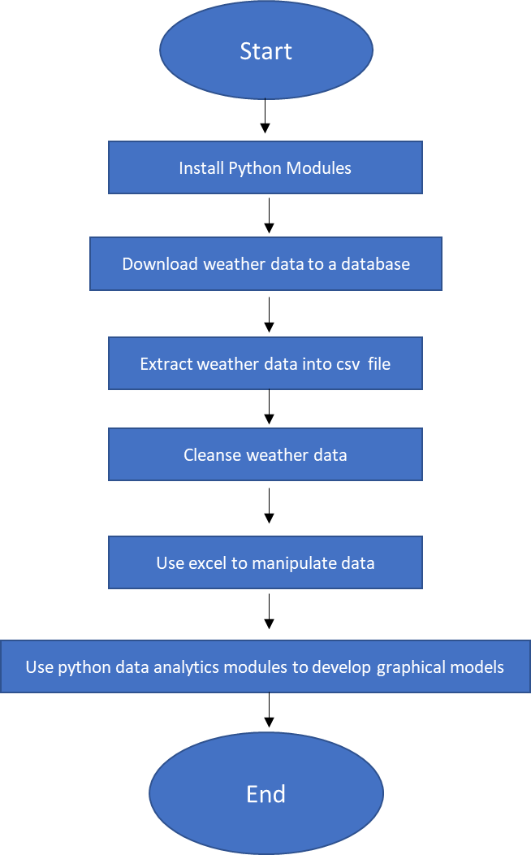
Flowchart
Install Python
Download Weather data to a database
Extract weather data from database into a comma separated file with Python
Cleanse weather data
Use excel to manipulate data
Use python data analytics modules to develop graphical models

Slide 7
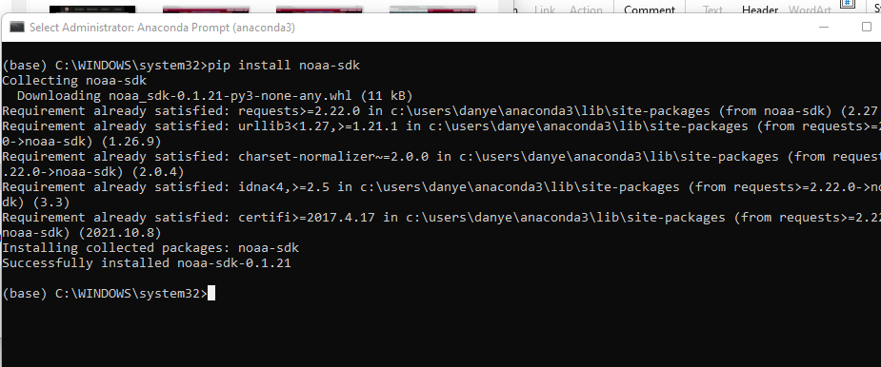
Adding Library
In order for python to connect to the US government National Oceanic Atmospheric Administration (NOAA) weather data service using a cloud-based Application Programming Interface (API), a library module must be installed to use this service
The screenshot shows the NOAA-SDK library installed

Slide 8
Gathering Temperature and Humidity data
After planning and design, code was developed to download a set of weather observations
This data was stored on a local database in a table for later analysis

Slide 9
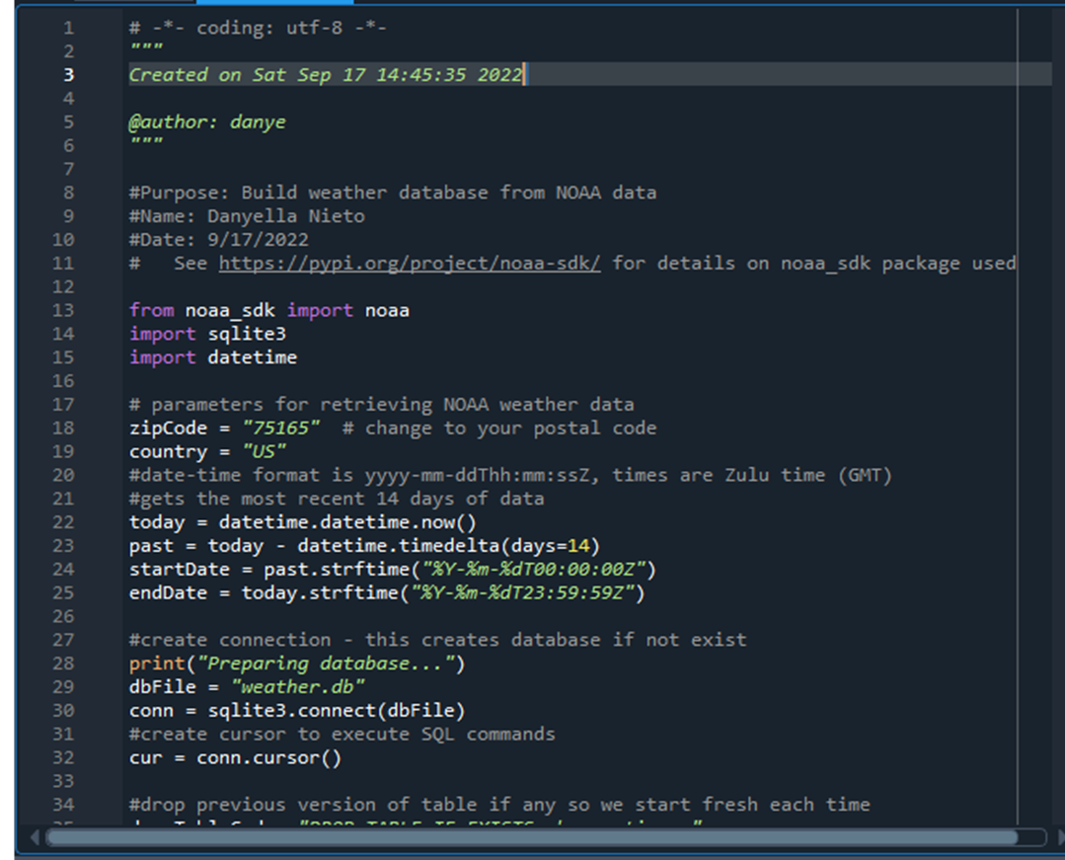
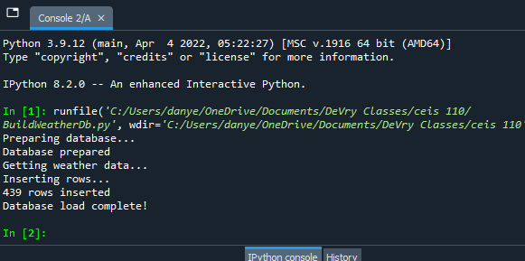
BuildWeather.Db.py Code (screenshot)
Screenshot of code in Spyder
The code will create a table named Observations with the fields: timestamp, windspeed, temperature, relativeHumidity, windDirection, barometricPressure, visibility, and textDescription
The database will be named weather.db and stored in the same directory as the python code

Slide 10
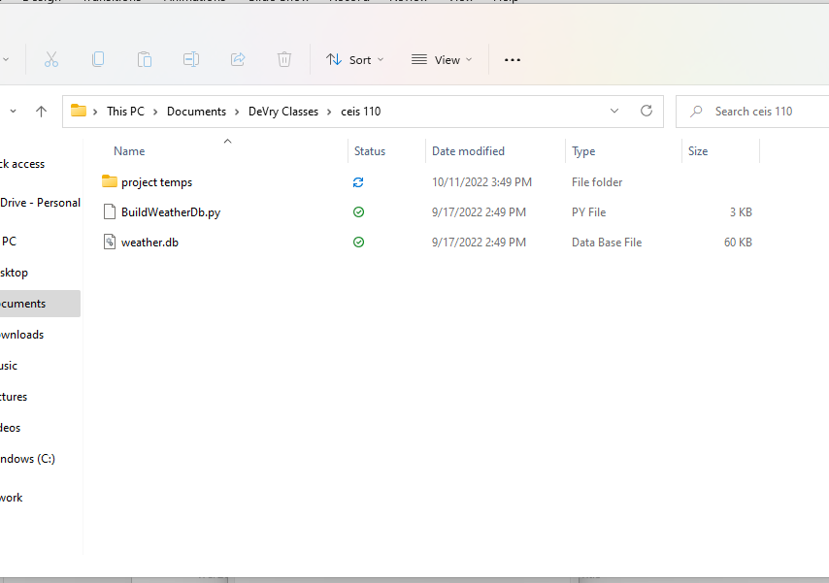
Weather.db File (screenshot)
Screenshot of Windows Explorer showing database file Weather.db was created

Slide 11
Querying the Database
Structured Query Language (SQL) is a programming language used for working with relational databases
SQLiteStudio was used to query the database and view the results

Slide 12
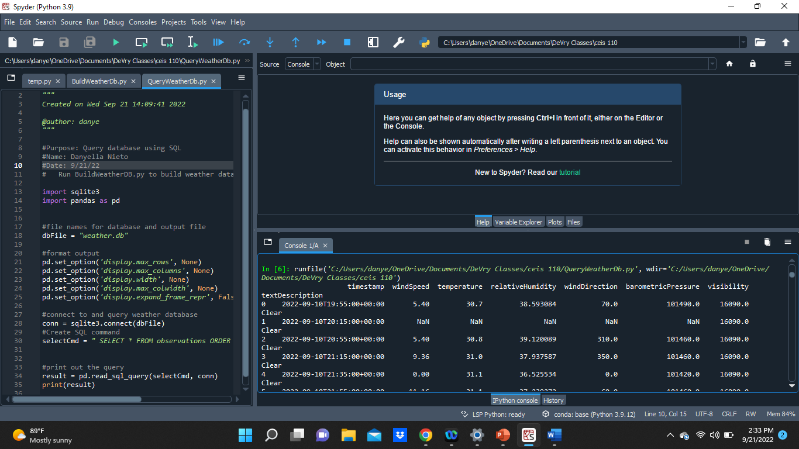
Query to retrieve all columns and all rows (screenshot)
The SQLa command “select * from observations” was executed to retrieve all rows and columns from the observation table

Slide 13
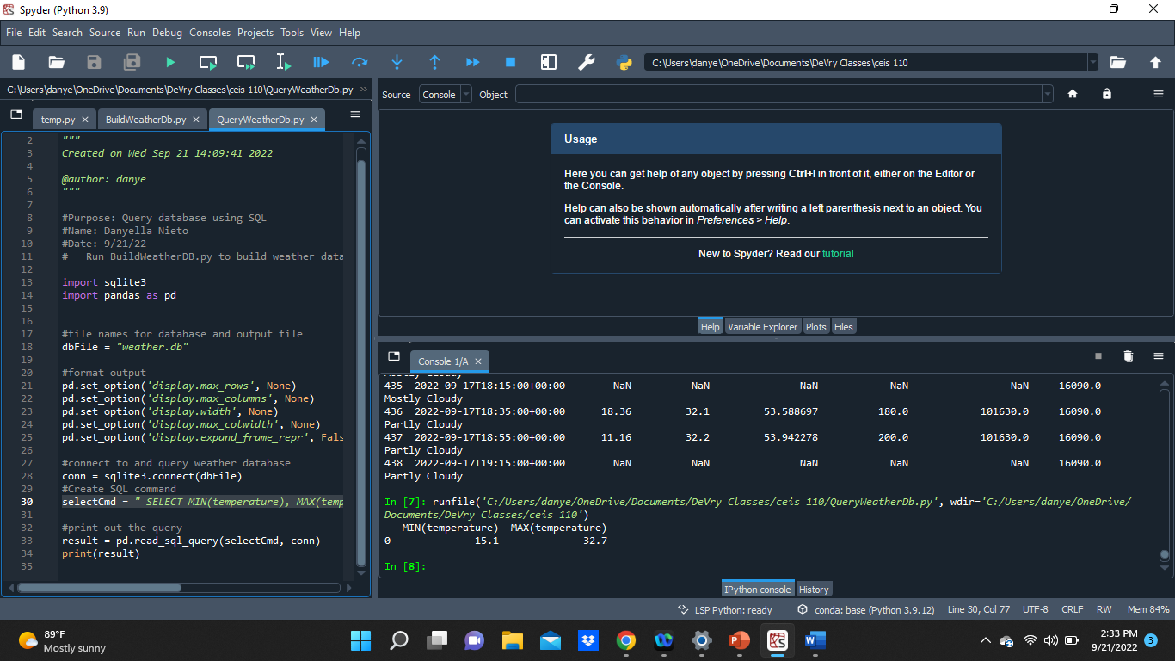
Query to retrieve lowest and highest temperatures (screenshot)
The min and max temperatures were retrieved. These temperatures are captured based on the Celsius scale

Slide 14
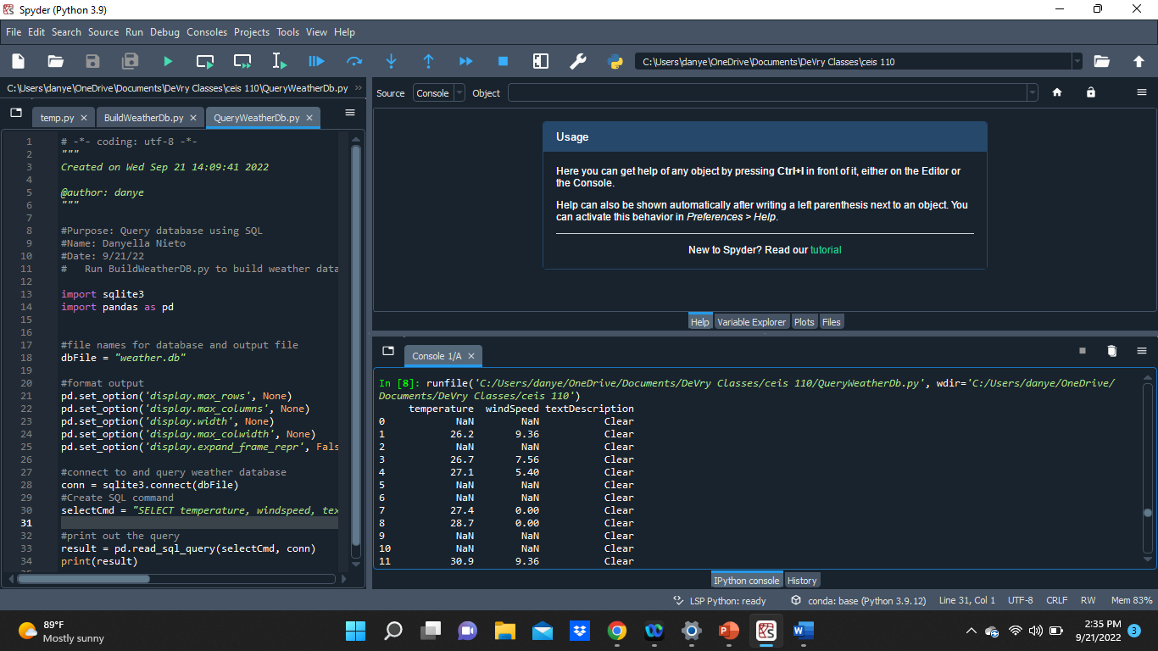
Query to retrieve all clear days (Screenshot)
Another Query was performed to retrieve all clear days. The textDescription column was used to retrieve this information

Slide 15
Data Cleansing
Data output from machines have errors or extraneous data. When cleansing the data, programs can automatically put in the format needed to be read by other programs.
A python program is reading in the data output by the python program and saving it as a csv file so that it can be read by Excel.
Often data must be cleansed of spurious or missing values in a dataset. The data must be complete, valid and standardized.

Slide 16
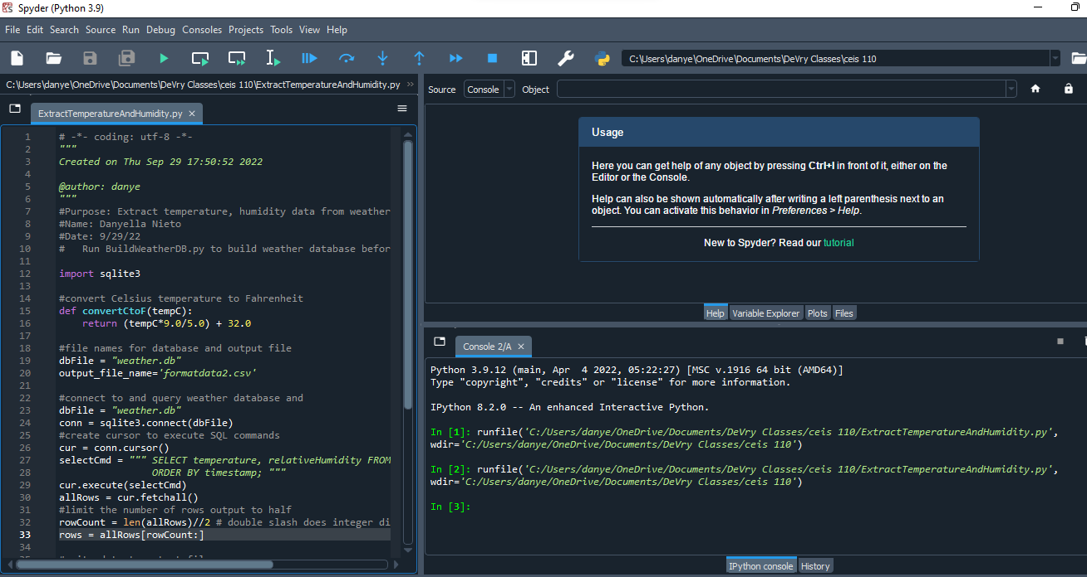
Extracting Temperature and Humidity using Python code
The weather.db database may contain null or missing values. The code used retrieves only the temperature and humidity values and writes them to a comma separated values (CSV) file. Two files are created – a formatdata.csv and a formatdata2.csv that each contain half of the rows. Missing or invalid values are not written to the file.

Slide 17
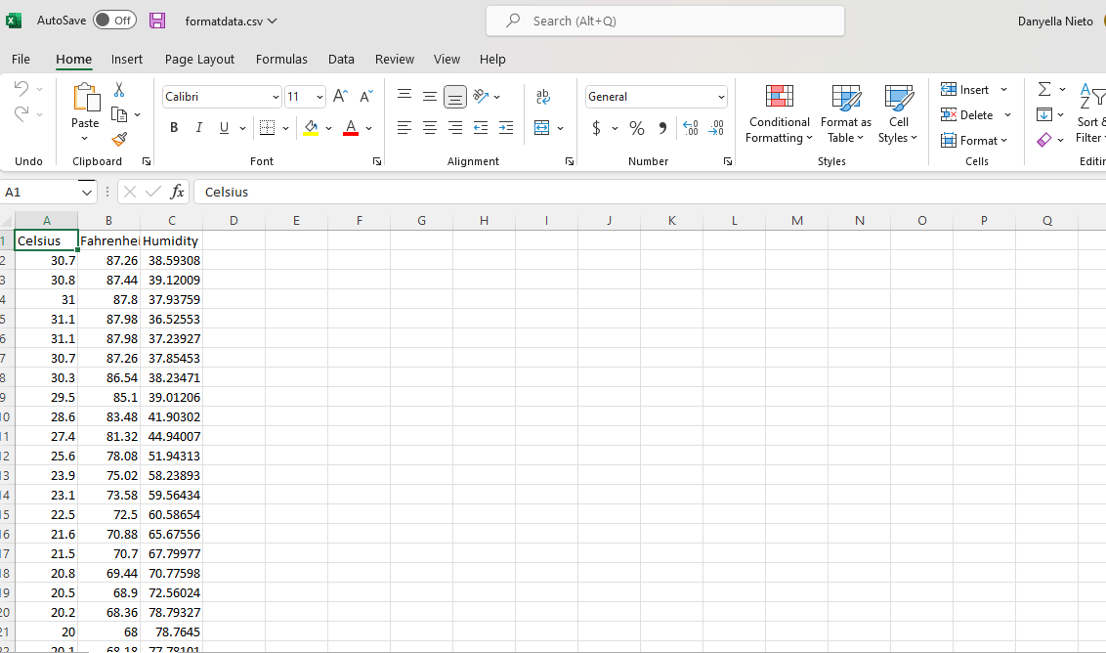
Data Formatted in an Excel Spreadsheet
The Python program creates a formatdata.csv file
The file contains 3 columns: Celsius, Fahrenheit, and Humidity
Statistics cab be performed on this spread sheet

Slide 18
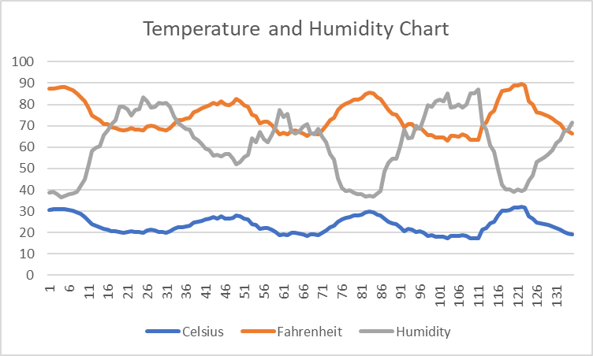
Data Visualization
A line chart was developed in Excel showing the Temperature and Humidity over Period 1

Slide 19
Data Analytics
Python Data analytics modules allows users to develop charts and graphs depicting data.
The data sets can be manipulated as well and saved into tabular format.
The data analytics modules are available as part of Anaconda.
Several plats were generated looking at humidity and temperature.
Then a prediction was made about the data.

Slide 20
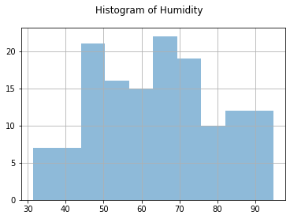
Histogram of Humidity
#Purpose: Create a histogram of humidity data from the second period
#Name: Danyella Nieto
#Date: 10/7/2
import pandas as pd
import matplotlib.pyplot as plt
df1 = pd.read_csv("formatdata.csv")
df2 = pd.read_csv("formatdata2.csv")
df2['Humidity'].hist(bins=10, alpha=0.5); plt.suptitle('Histogram of Humidity’)
plt.show()

Slide 21
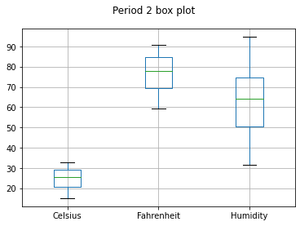
Period 2 Box Plot
#Purpose: Create box plot for period 2 data
#Name: Danyella Nieto
#Date: 10/07/2022
import pandas as pd
import matplotlib.pyplot as plt
df2 = pd.read_csv("formatdata2.csv")
df2.boxplot(); plt.suptitle('Period 2 box plot')
plt.show()

Slide 22
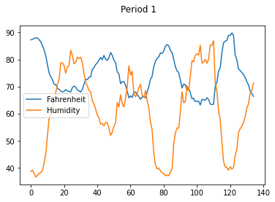
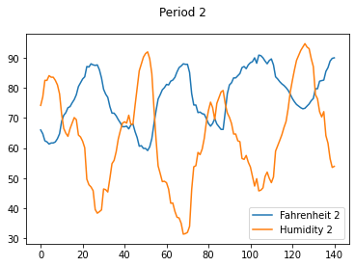
Analysis
The next step in analysis is developing a question and reviewing the data to answer the question. A chart can be used to look at the data
My question: Is there a correlation between the temperature in Fahrenheit and the humidity?
I created 2 line plots for trial. One with Fahrenheit vs Humidity for Period 1 and one for Fahrenheit vs Humidity for Period 2
In both it looks like there is an inverse relationship between the temperature in Fahrenheit and humidity

Slide 23
Code
#Purpose: Create 2 plots comparing Fahrenheit and humidity for Period 1 and 2
#Name: Danyella Nieto
#Date: 10/7/22
import pandas as pd
import matplotlib.pyplot as plt
df1 = pd.read_csv("formatdata.csv") #baseline data is period 1 (older)
df2 = pd.read_csv("formatdata.csv") #baseline data is period 1 (older)
df3 = pd.read_csv("formatdata2.csv") #data for period 2 (more recent)
df4 = pd.read_csv("formatdata2.csv") #data for period 2 (more recent)
plt.figure(); df1.Fahrenheit.plot(label = 'Fahrenheit'); df2.Humidity.plot(label = 'Humidity'); plt.legend(loc='best'); plt.suptitle('Period 1')
plt.show()
plt.figure(); df3.Fahrenheit.plot(label = 'Fahrenheit 2'); df4.Humidity.plot(label = 'Humidity 2'); plt.legend(loc='best'); plt.suptitle('Period 2')
plt.show()

Slide 24
Prediction
Based on the evidence and current data I would predict that as the weather starts cooling down more the humidity will increase and as the temperature fluctuates the humidity will follow inversely.

Slide 25
Challenges
When creating the python program, it needed to be in the same directory as weather.db
Misspelling the NOAA library install

Slide 26
Career Skills
Several career skills are gained in this project
Communication – Using flowcharts to depict the plan of a project
Database development
Programming using Python
Troubleshooting errors in the code and data cleansing
Analysis – Reviewing charts and graphs to make predictions on the data

Slide 27
Conclusion
This project covered the fundamental topics of programming with data by using data gathered from a cloud service to preform data analytics operations
Building this project provided a hands-on learning opportunity to put into practice the topics overed in the course

