Slide 1

SOHO Network setup
NETW 191
Danyella Nieto

Slide 2

Introduction
In this project I will demonstrate assigning IPV4 addresses, testing connectivity, IP subnetting and loopback interfaces, network diagrams, and dive into SOHO Wireless Network Security

Slide 3

challenges
Identifying subnetting
Ensuring correct IPV4 is assigned
Applying subnetting with proper IP address

Slide 4
Career Skills
Network Building
Creating Diagrams
Identifying cables and troubleshooting

Slide 5
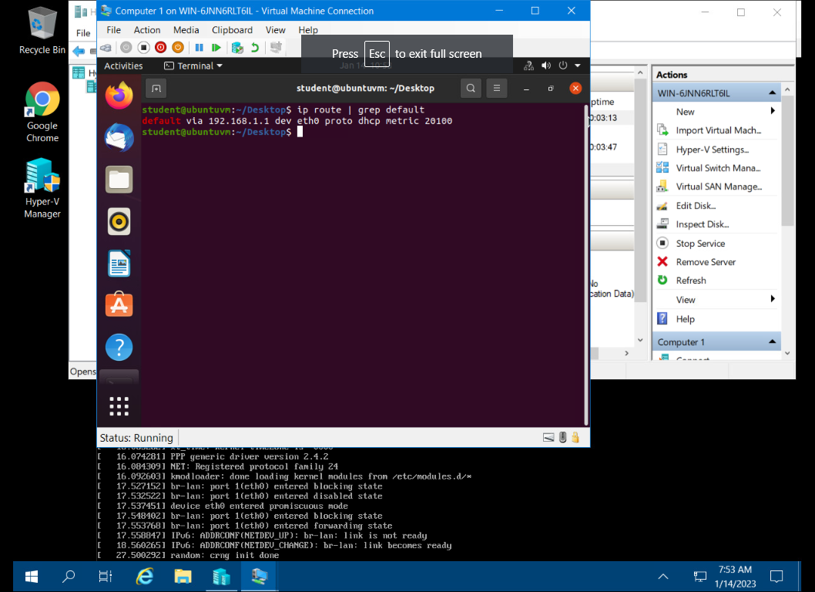
IPv4 Addressing
Preparation
This screenshot includes the terminal window that shows the default gateway IP address.

Slide 6
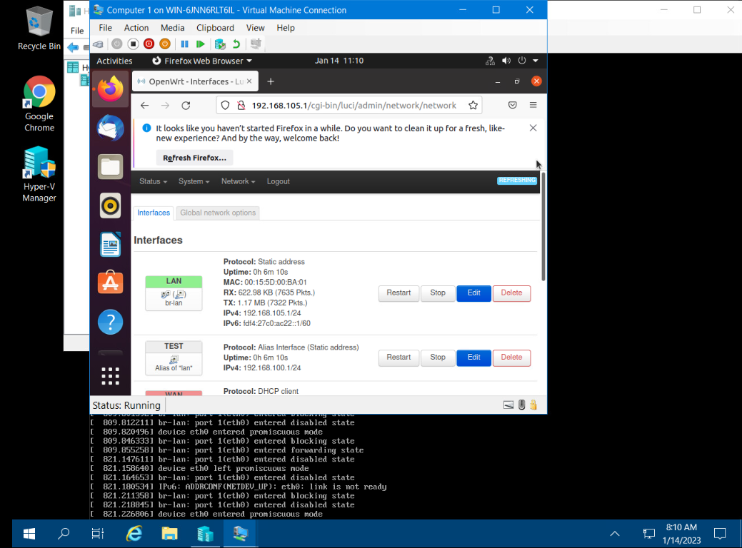
IPv4 Address
Assignment
This screenshot includes the Interfaces page that shows the new IPv4 address on the LAN interface.

Slide 7
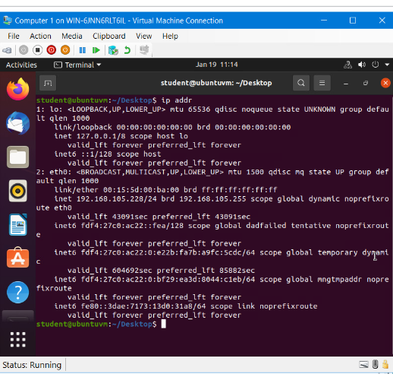
Connectivity Test
Dynamic IP Address Assignment
This screenshot shows the IPv4 address of the Computer 1 VM.

Slide 8
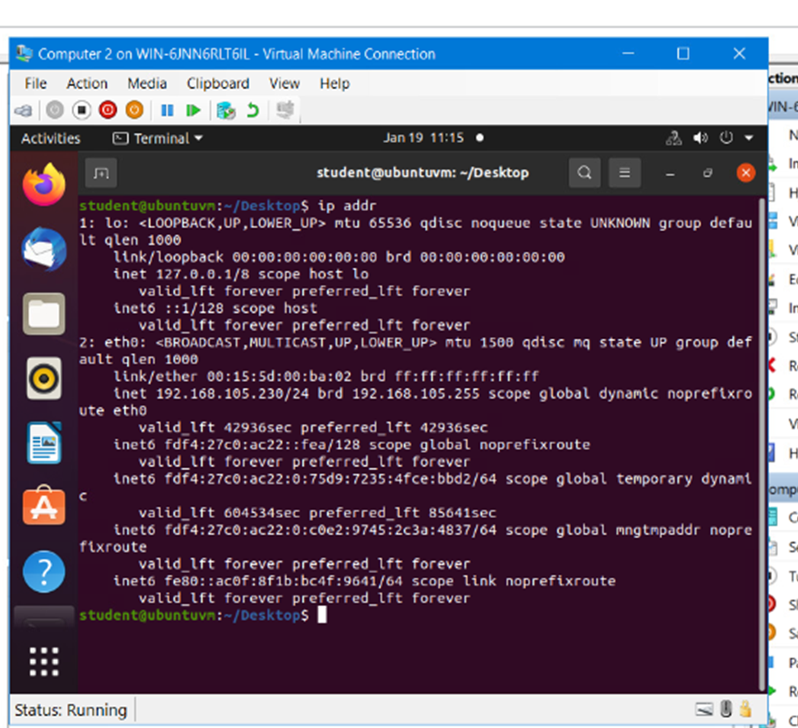
Dynamic IP Address Assignment
This screenshot shows the IPv4 address of the Computer 2 VM.

Slide 9
Visio Network Diagram
 | Subnet ID | Network Mask (/prefix) | Network Mask (Dotted decimal) | Network Address | First Usable Host Address | Last Useable Host Address | Broadcast Address
The First Subnet | 0 | /25 | 255.255.255.0 | 192.168.5.0 | 192.168.5.1 | 192.168.5.127 | 192.168.5.127
The Second Subnet | 1 | /25 | 255.255.255.128 | 192.168.5.128 | 192.168.5.129 | 192.168.5.254 | 192.168.5.254
Subnetting Table
This table includes two /25 subnets, listing the subnet notation, network address, first usable host address, last usable host address, and broadcast address of each subnet.

Slide 10
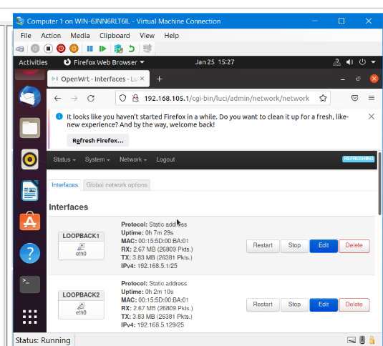
Loopback Interfaces
This screenshot shows both Loopback1 and Loopback2 interfaces and their correct IPv4 addresses.

Slide 11
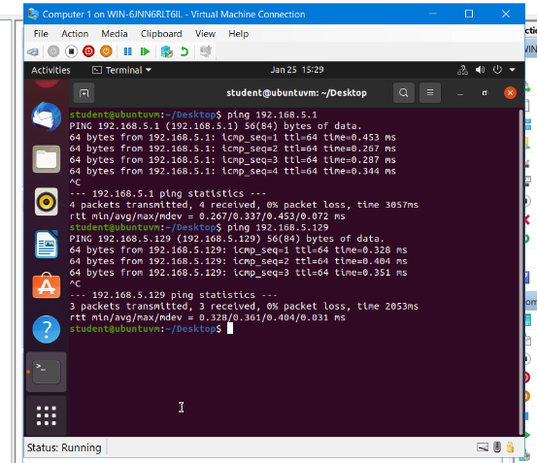
Connectivity Tests
This screenshot shows two successful ping tests from the Computer 1 VM to the Loopback 1 and Loopback 2 interfaces.

Slide 12
Microsoft Visio Network Diagram
This diagram illustrates the interconnection of the Computer 1 VM, the Computer 2 VM, and the SOHO Router VM.

Slide 13
SOHO Wireless Network Security
1. What are the factory default username and password of a TP-Link router? Why is it important to change the default username and password of a SOHO router?
Answer:Default username – admin // default password - admin
Anyone can find the default username and password easily through the internet including hackers
2. To protect a SOHO wireless network with a small number of devices, which address management method provides more control, configuring the device IP addresses manually (static IP) or using a DHCP server (dynamic IP)? Why?
Answer:Static IP addressing is more secure and allows more control but need more admin overhead and it is not as flexible. New IP configurations will require admin to redo the addressing process, DHCP is easier for IP configuration management and flexible but opens to a range of address which some of them could be unused. – Available IP address for hackers
3. What does MAC filtering do? If needed, when would you use deny filtering rules and when would you use allow filtering rules? What happens to devices that want to connect, if the “Allow the stations specified by any enabled entries in the list to access” function is enabled but there are no entries in the list?
Answer:It is a feature that allows you to control the wireless stations accessing the AP, which depend on the station’s MAC addresses. (MAC address from the Ethernet NIC) Deny filtering rule is to decide whether the wireless stations cannot access the wireless AP. Allow filtering rule is to decide whether the wireless station can access the wireless AP. If there are not any enabled entries in the list, thus no wireless stations can access the AP

Slide 14
SOHO Wireless Network Security
4. What wireless security settings are displayed on the Wireless Security page? Which one is recommended by the vendor? Why?
Answer:
Disable Wireless Security
WPA / WPA2 – Personal – Select WPA based on pre-shared passphrase. (PSK)
WPA/WPA2 – Enterprise – Select WPA based on Radius Server.
WEP – Select 802.11 WEP security.
Strongly recommend to enable wireless security and select WPA-PSK AES encryption. AES provided longer key lengths 128-bit, 256-bit or longer keys make it more difficult to crack
5. Among the configurations you explored in this module, which one is a true security function? Why?
Answer: Wireless Security setting using authentication and encryption protocols (RADIUS. 802.1x, PSK, TKIP, WPA2, WPAJ to protect the wireless access password. Change the default admin username and password – Non-mandatory PW policy MAC filtering- Validity of MAC address – MAC address spoofing, Static & DHCP – Ip address configuration
6. What would you do to protect your wireless network at home? Why?
Answer: Use a VPN, turn on a firewire and set up ALG and set up a guest network, you would do these to make your network more secure and be able to monitor and shield how things are being sent and received to your network

Slide 15
Conclusion
Completing this project has provided me with skills necessary to work with network devices. I have gained knowledge of IP addressing and subnetting and how to demonstrate the dynamic through a visual diagram. This course and project has aided me in verifying connectivity through testing and demonstrating loopback interfaces.

Slide 16
Resources
1. https://emulator.tp-link.com/902AC_US_Emulator/Emulator_Router/index.htm
2. https://www.routerpasswords.com/tp-link-default-router-password/
3. https://www.tp-link.com/us/support/emulator/

Slide 17

Thank You

