Slide 1
Smart Home System
Danyella Nieto
CEIS 101

Slide 2
Introduction
This project covers the fundamental concepts of the IoT by integrating hardware, software, and networks into a single system. The project is divided into six parts. Each part builds upon the previous, resulting in an IoT design that simulates a smart home system. The development process of this project encompasses different aspects of the IoT.

Slide 3
Challenges
There were some challenges during the creation of the project. The challenges came when transferring the design from Tinkercad and building the system in real time. I had difficulty finding the needed light measurements to activate the blue LED.

Slide 4
Career Skills
Experience with hardware
Trouble shooting skills
Inputting code
Running simulations

Slide 5
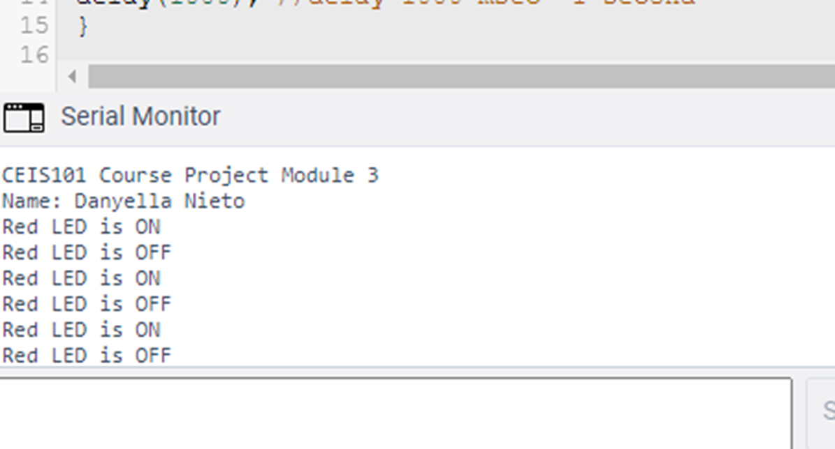
Phase One

Slide 6
Phase One cont.
In phase one the goal was simple. It was to add an LED and code it to flash in one second increments. The image to the left shows the LED illuminated and the image to the right shows the serial monitor displaying the status of the LED.

Slide 7
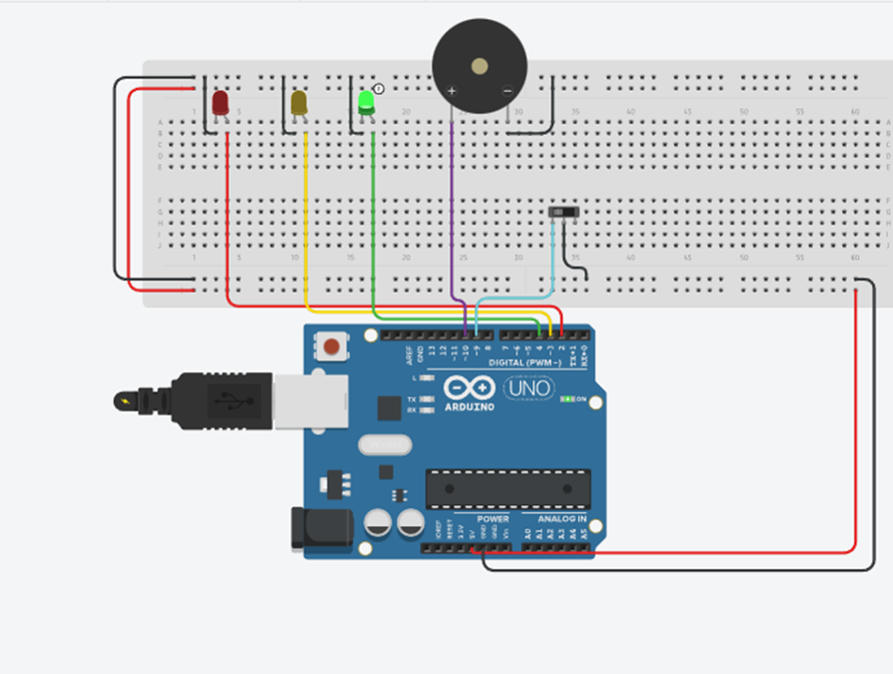
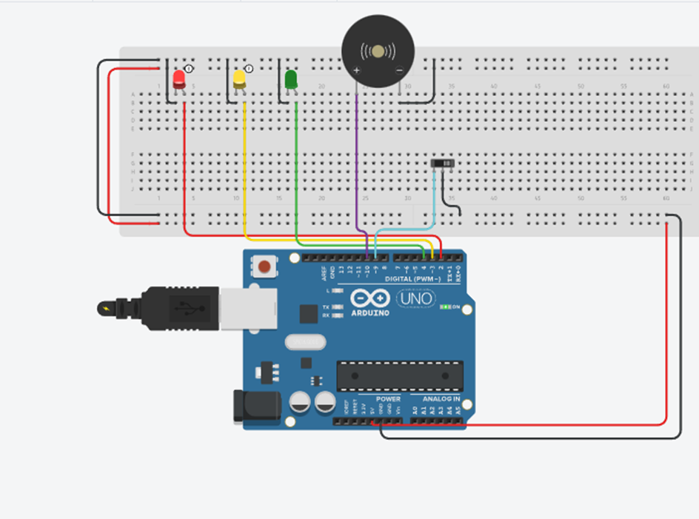
Phase Two
Door Alarm Not mmEngaged
Door Alarm Engaged
Serial Monitor

Slide 8
Phase Two Cont.
In phase two, 2 more LED’s were added as well as a door sensor. The green LED is illuminated when the door sensor is making a complete connection. Once the connection is disturbed such as the door opening the door alarm engages turning off the green LED and illuminating the red and yellow LED’s. Along side the LED’s there is a buzzer that is activated when the connection is disturbed.

Slide 9
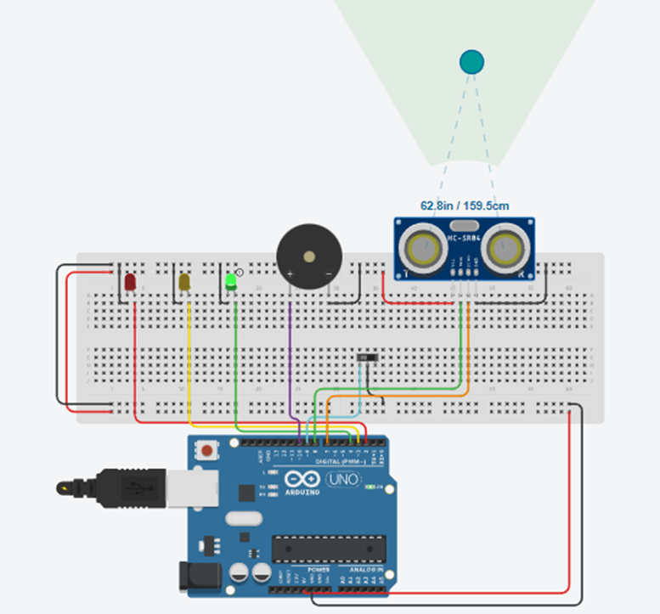
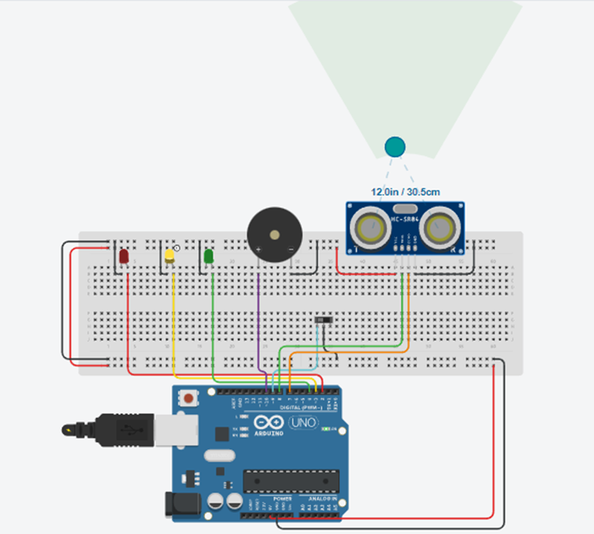
Phase Three

Slide 10
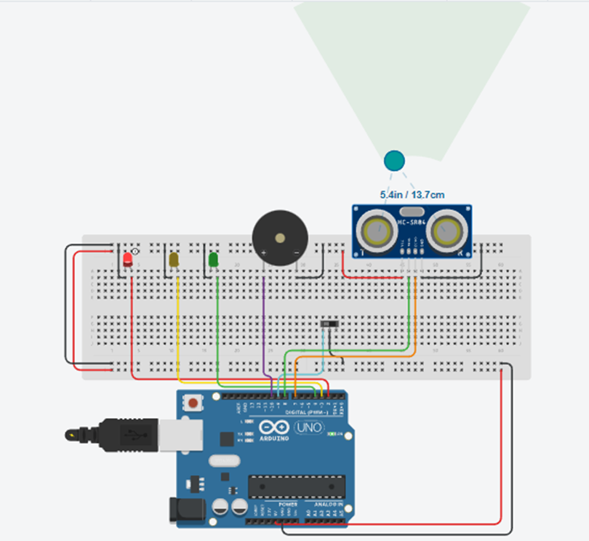
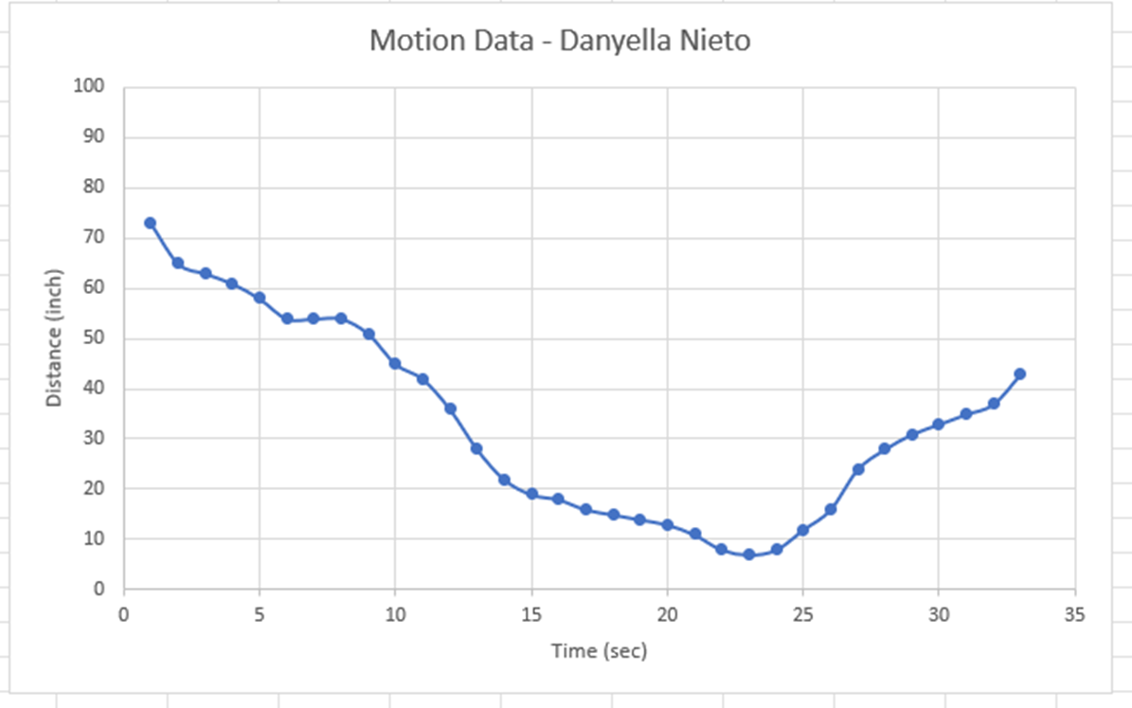
Phase Three Cont.

Slide 11
Phase Three cont.
In phase three a distance sensor was added. The sensor was tied in with the already existing three LED’s. The sensor is quiet and the green LED is illuminated when on object is further than 12 in out. When the object is between 12 and 6 in away the yellow LED illuminates and the sensor starts to beep. If the object is less than 6 in. away the red LED illuminates and buzzer beeps more rapidly.

Slide 12
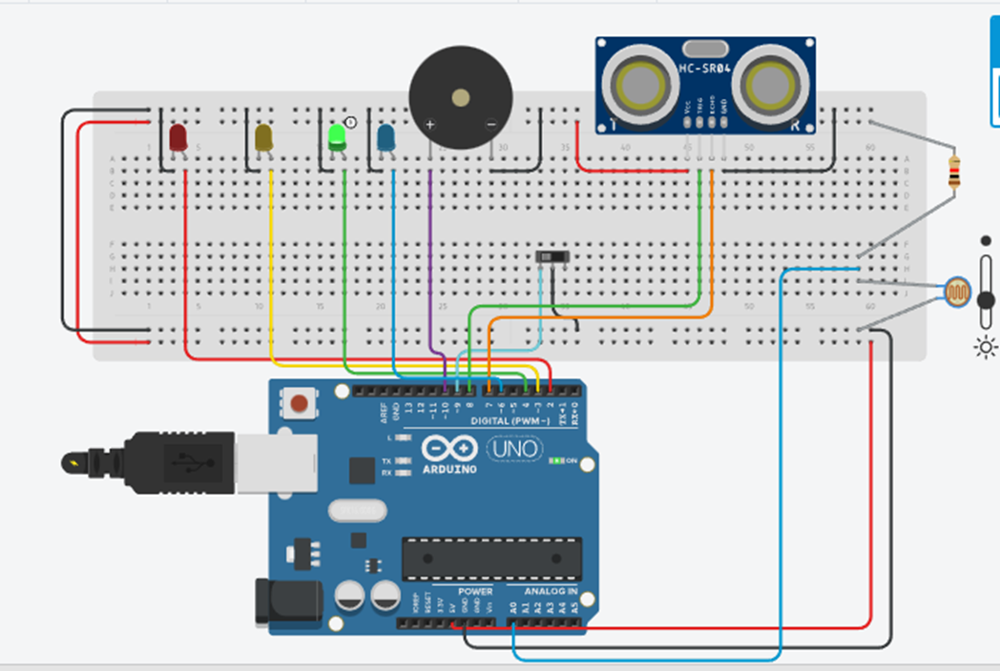
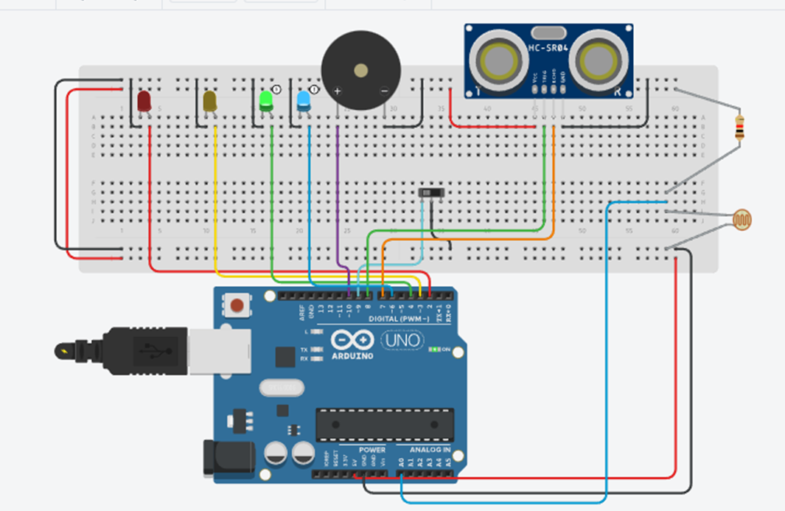
Phase Four

Slide 13
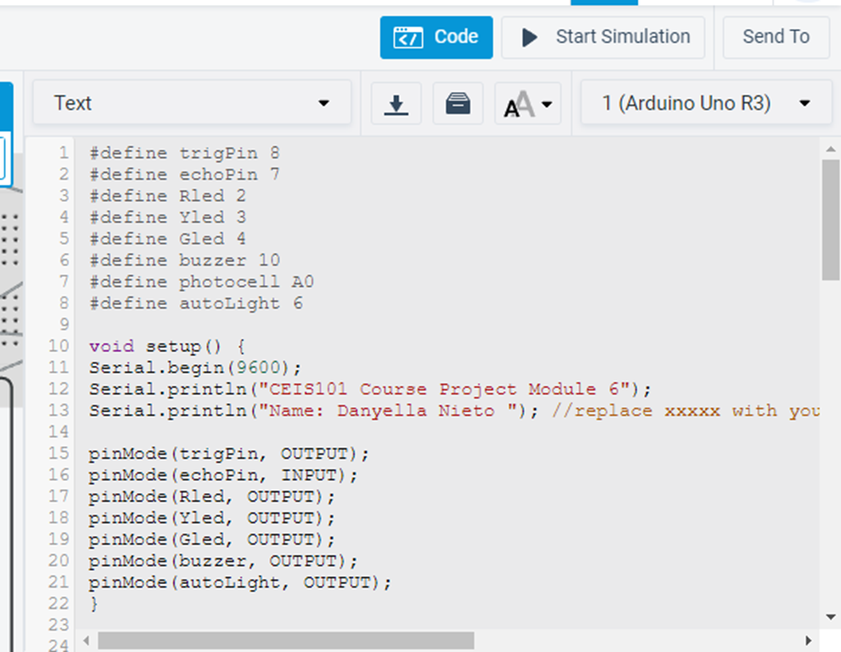
Phase Four cont.
In phase four a blue LED is added as well as a photoresistor. The blue LED is programmed to be an automatic light based off the amount of light the photoresistor receives.

Slide 14
Conclusion
This project has aided in my skill development. I have been able to create a smart home security simulation that incorporates automatic lights, door sensors and distance sensors. I have gained knowledge of incorporating hardware, software and networks. The invaluable skills I have gained are transferable to many aspects in technology and the IoT.

Slide 15
References
https://learn.comptia.org/app/comptia-certmaster-learn-for-itf-fc0-u61-elearning#read/table-of-contents

