Slide 1
Smart Traffic light
CEIS 114 Danyella Nieto

Slide 2
Breakdown
INTRODUCTION
Challenges
Career skills
Project construction
Peer review
SUMMARY

Slide 3
INTRO
In CEIS114 we were introduced to the different types of circuits, currents and connections and those elements play their part in microprocessors and the importance of resistors in the function of devices. The knowledge from these topics played a crucial role in creating a smart traffic light prototype.

Slide 4
Challenges
Faulty wires and equipment, securing wiring, ensuring the code functions properly

Slide 5
Career skills
Creating complete circuits, utilizing materials with needed voltage for your project, using OSI layer model, trouble shooting

Slide 6
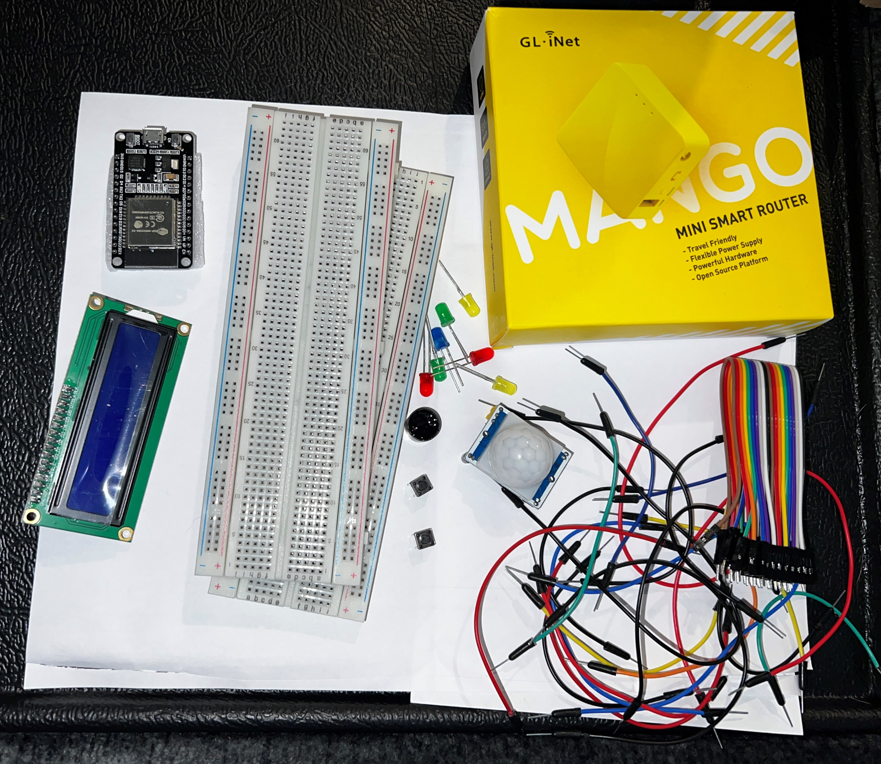
Inventory
ESP 32 Board
Colored LEDs: Red, Yellow, Green, and Blue
Wires
Breadboard(s)
LCD Unit with I2C Adapter
Active Buzzer
Mini Router
Push Button(s)
PIR Motion Sensor

Slide 7
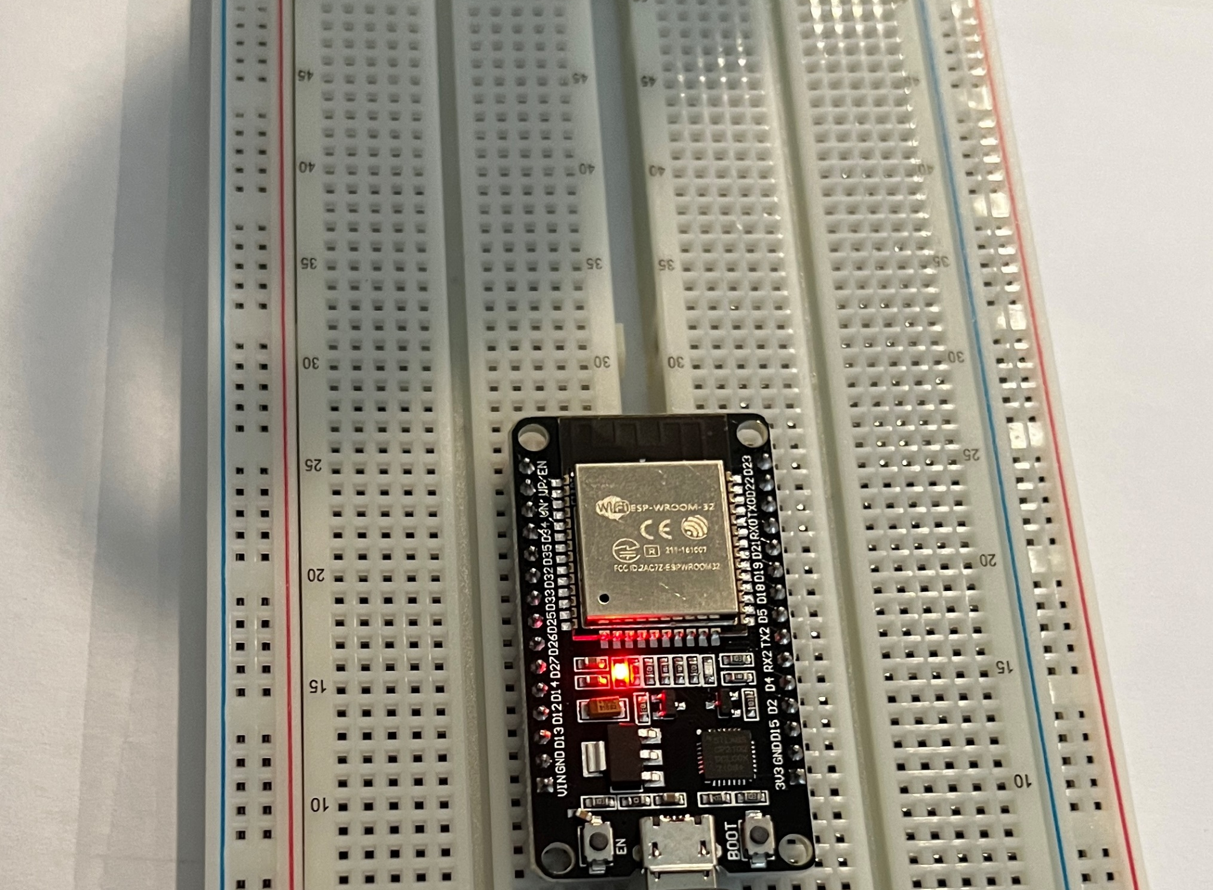
ESP32
Microcontroller mounted and powered ON

Slide 8
Creating the Traffic Controller
ESP 32 Board
Colored LEDs: Red, Yellow and Green
Wires
Breadboard
Screenshot of code in Arduino IDE
Picture of circuit with working LEDs

Slide 9
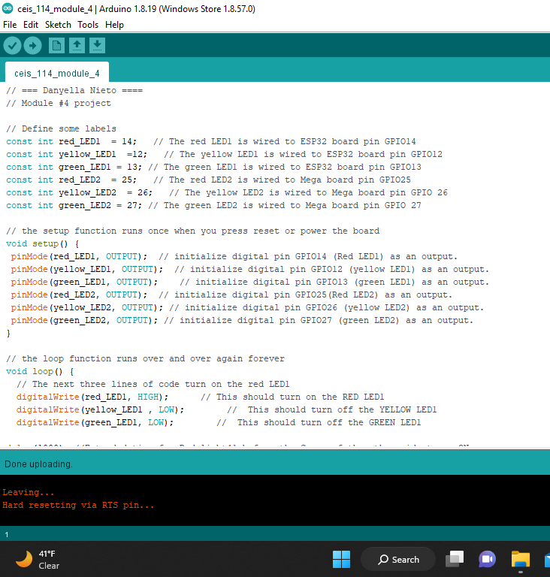
Creating a Multiple Traffic Light Controller
Picture of circuit with working LEDs
Screenshot of code in Arduino IDE

Slide 10
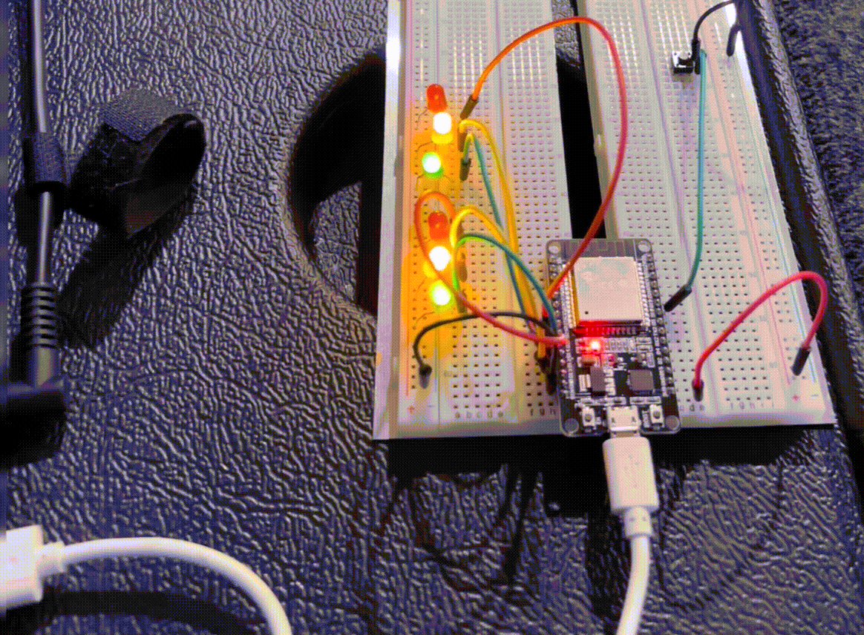
Creating a Multiple Traffic Light Controller with a Cross Walk
Picture of circuit with working LEDs
ESP 32 Board
Colored LEDs: Red, Yellow and Green (two sets)
Push Button
Wires
Breadboard

Slide 11
Screenshot of Serial Monitor in Arduino IDE

Slide 12
Screenshot of code in Arduino IDE

Slide 13
Creating a Multiple Traffic Light Controller with a Cross Walk and an Emergency Buzzer

Slide 14
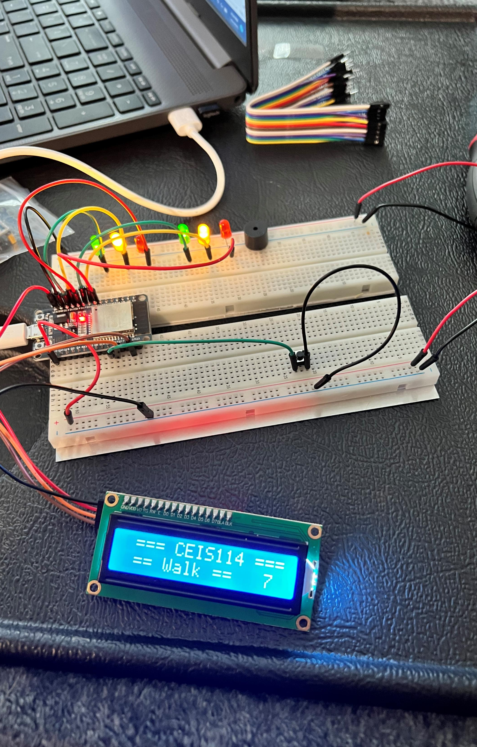
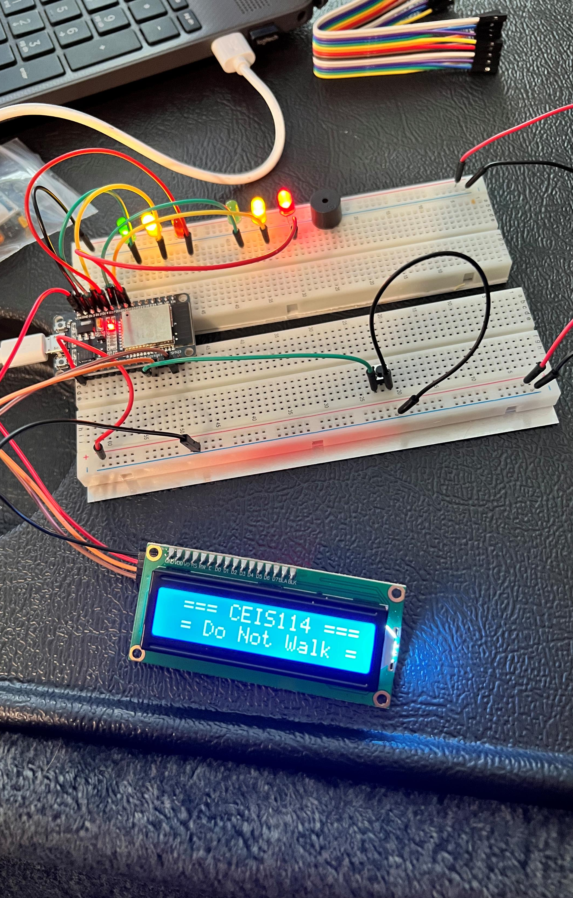
Picture of circuit with working LEDs and LCD display
ESP 32 Board
Colored LEDs: Red, Yellow and Green (two sets)
Push Button
LCD Unit with Message Display
Wires
Breadboard

Slide 15
Screenshot of Serial Monitor in Arduino IDE

Slide 16
Screenshot of code in Arduino IDE

Slide 17
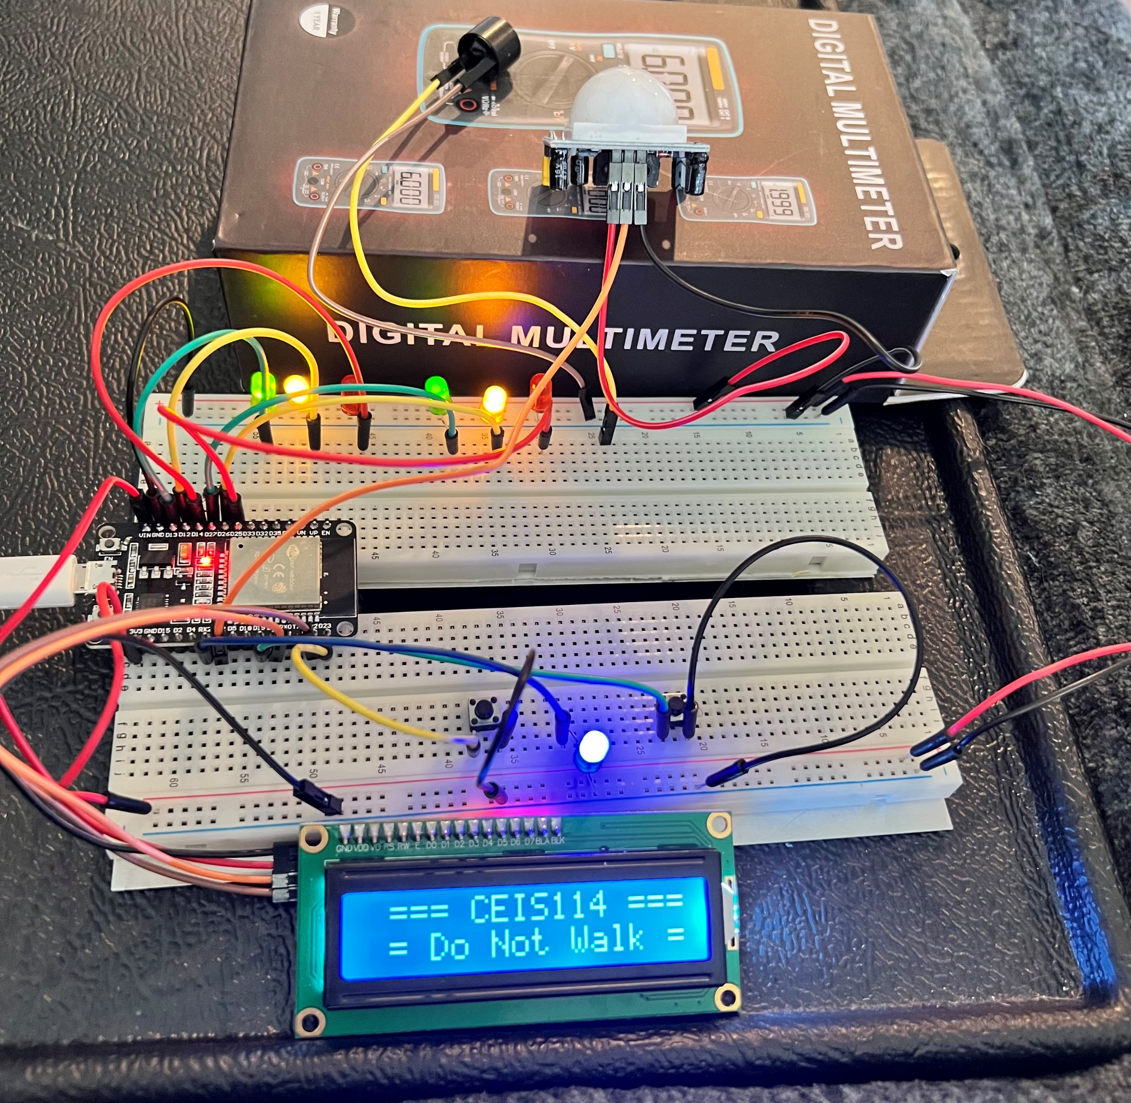
Creating a Multiple Traffic Light Controller with a Cross Walk and an Emergency Buzzer with SMART sensor
Picture of circuit with working LEDs and LCD display

Slide 18
Screenshot of Serial Monitor in Arduino IDE

Slide 19
Screenshot of code in Arduino IDE

Slide 20
Peer review

Slide 21
Peer review Reflection

Slide 22
SUMMARY
In creating the smart traffic light prototype I was able to take the skills and lessons taught in CEIS 114 and apply them to a hand on project. I was able to set up a multi traffic light controller with a crosswalk button, emergency button, a motion sensor and LCD monitor. The skills I have learned are extremely valuable and will be applied in my future projects and career .

Slide 23
references
CEIS 114 lectures
CEIS 114 modules
Professor Muqri

Slide 24
THANK YOU
Danyella Nieto
dnieto4@my.devry.edu
https://dnieto47.wixsite.com/danyella-s-technical

